Slide 1
GALE IN CONTEXT: ELEMENTARY
Parts of Poetry

Slide 2
TABLE OF CONTENTS
1 | Cover
2 | Table of Contents
3-4 | Escape Room Instructions and Arrangements
5 | Resource Access
6 | Printing Suggestions for Activities
7 | Answer Sheet
8 | Teacher Answer Key
9-11 | Description Cards for Stations or Folders
12 | Task 1 Directions: Rhyme
13 | Task 1 Cut-and-Sort Activity
14 | Task 2 Directions: Syllables
15 | Task 2 Comparing Haikus Activity
16 | Task 3 Directions: Alliteration
17 | Task 3 Emoji Maze Activity
18 | Task 4 Directions: Metaphor
19 | Task 4 Alphabet Cipher Fill-in-the-Blank Activity
20 | Task 4 Animal Alphabet Cipher
21 | Task 5 Directions: Onomatopoeia
22 | Task Crossword Puzzle Activity
23 | Citation Information

Slide 3
GENERAL INSTRUCTIONS
BEFORE
Print and organize all necessary activity materials (see Printing Suggestions). Some stations consist of cut-and-sort activities. You can choose to have students cut these as they progress and then sort or, you can have them cut and placed in envelopes or folders before they begin.
Tasks can be set up as stations or as completion tasks where groups remain in one location. In either setup, it is important to have materials prepared that equal the number of groups. Having a folder/envelope for each task is best practice.
Gale resources should be accessed through the Gale In Context: Elementary database. (See Resource Access page).
DURING
Walk around the room and assist groups when necessary. Each time a group finishes a task, check their code to approve them to go onto the next one.
AFTER
Review reading material with students. This activity works well as an introduction to a topic, or as a culminating activity at the end of a unit. Students can reflect about what they learned during the activity with reflection writing or use what they learned as a starting point for a deeper research project.
TASK-SPECIFIC INSTRUCTIONS
TASK 1:
Instructions: Students will watch the assigned video on Gale In Context: Elementary titled “Block City: A Classic by Robert Louis Stevenson.” . As they watch and listen, they will match the lines from the poem that have the same end rhyme.. When in the right pairs, the letters will be the code they will write on their answer sheet. *Note that the video does speak quicky. There is a transcript below the video for those students who want to read or follow along.
Arrangements: If students are working in groups, have them view the video together or watch individually. See Resource Access for best practices on sharing Gale content with students. The activity for this is a cut-and-sort activity. You should have them precut and stored in an envelope or bag.

Slide 4
TASK 2:
Instructions: Students will read the assigned Gale In Context: Elementary document, “Nature Haikus” so see examples of Haiku and practice counting syllables. They will then compare two poems given to them and determine which is a Haiku based on the number of syllables in each line. They will record the title of the correct poem on the answer sheet under Task 2
Arrangements: Each group will need a set of the 4 poems. The poems can either be cut into strips or left on the same sheet when given to students. See Resource Access for best practices on sharing Gale content with students.
TASK 3:
Instructions: Students will read the assigned Gale In Context: Elementary document, “Alliteration.” They will then find their way out of the emoji maze by determining which emoji correctly completes to alliteration on each square. They will record the direction they went with an arrow on their answer sheet under Task 3.
Arrangements: Each group will need one maze to work through together. See Resource Access for best practices on sharing Gale content with students.
TASK 4:
Instructions: Students will first read the Gale In Context: Elementary document “Metaphors.” Then students will use the animal alphabet cypher to complete each of the common metaphors from poetry. Each decoded word will be recorded on their answer sheet under Task 4.
Arrangements: See Resource Access for best practices on sharing Gale content with students. Each group will need a cipher and page of metaphors to decode. These can be printed on separate sheets or front and back. Printing front and back may make the task more challenging.
TASK 5:
Instructions: Students will read the Gale In Context: Elementary document, “Sound Safari: Exploring the World of Onomatopoeia.” They will then determine which word in each line is an example of onomatopoeia and complete their crossword with that term. The first letter of each word will be the code the put on their answer sheet in numerical order under task 5. This is how they finally “escape”!
Arrangements: Each group will need a crossword puzzle they can write on for this task. See Resource Access for best practices on sharing Gale content with students.

Slide 5
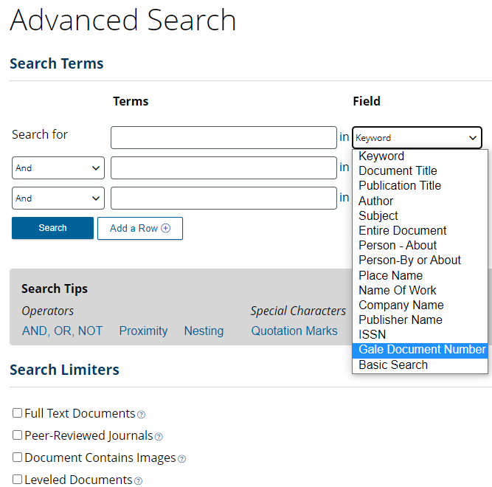
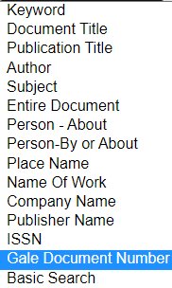
RESOURCE ACCESS
The best way to have students access task articles it to have them visit Gale In Context and perform an Advanced Search.
Provide students with the Gale Document Number.
They will then select Gale Document Number from the Field drop-down menu and enter the document numbers below to access the content for each task.
Task 1: Rhyme | GIIPUN182134852
Task 2: Syllables | A168361063
Task 3: Alliteration | SMASQC564832324
Task 4: Metaphor | TFDFZW944488296
Task 5: Onomatopoeia | A514405674
Articles can also be shared with students via the
Get Link tool.

Slide 6
PRINTING SUGGESTIONS
Page 7 | Answer Sheet
Page 8 | Teacher Answer Key
Page 9-11 | Description Cards for Stations or Folders (optional)
Page 12 | Task 1 Direction Cards (2 per page)
Page 13 | Task 1 Cut-and-Sort Activity
Page 14 | Task 2 Direction Cards (2 per page)
Page 15 | Task 2 Cut-and-Sort Activity
Page 16 | Task 3 Direction Cards (2 per page)
Page 17 | Task 3 Maze Activity
Page 18 | Task 3 Direction Cards (2 per page)
Page 19 | Task 3 Fill-in-the-Blank Activity using Cipher
Page 20 | Task 3 Cipher Tool
Pages 21 | Task 4 Direction Cards (2 per page)
Page 22 | Task 4 Crossword Puzzle
Notes:
Some documents are 2-per page to decrease the number of needed copies. Once cut-and-sort activities are printed and cut out, it is recommended to keep them in an envelope or bag for each group. Consider laminating for future use.
It is recommended that you make 1 copy per student of the cipher (page).

Slide 7
ANSWER
SHEET
Gale In Context: Elementary
Parts of Poetry
Group Members:
TASK 1 | F |  | B |  | C |  | D
TASK 2
TASK 3
1. ____________________________________
2. ____________________________
3. ______________________________
4. ____________________________________
TASK 4
1.
2.
3.
4.
5.
6.
TASK 5
1 | 2 | 3 | 4 | 5 | 6 | 7 | 8 | 9 | 10 | 11 | 12 | 13
YOU ESCAPED!

Slide 8
ANSWER
KEY
Gale In Context: Elementary
Parts of Poetry
Group Members:
TASK 1 | F | A | B | H | C | G | D | E
TASK 2
TASK 3
1. ____________________________________
2. ______________________________
3. ________________________________
4. ____________________________________
FISH
CATERPILLAR
OAK TREES
→ | ↓ | ↓ | → | ↑ | → | ↓
SLOTHS
TASK 4
1. | T | H | I | E | F
2. | S | T | A | G | E
3. | W | I | N | D | O | W | S
4. | L | O | V | E
5. | C | U | R | T | A | I | N
6. | D | I | A | M | O | N | D | S
TASK 5
B | M | T | C | C | R | D | H | S | M | B | S | B
1 | 2 | 3 | 4 | 5 | 6 | 7 | 8 | 9 | 10 | 11 | 12 | 13
YOU ESCAPED!

Slide 9
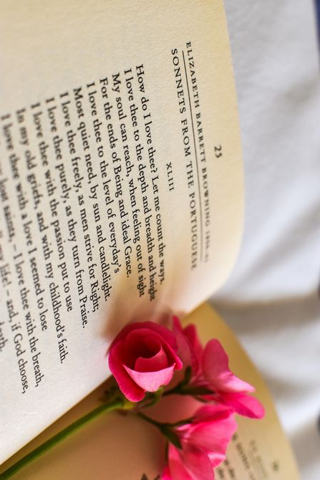
TASK 1
TASK 1
Use the Task 1 resources to complete your task and crack the code! Be sure to record answers on our group answer sheet.
Use the Task 1 resources to complete your task and crack the code! Be sure to record answers on our group answer sheet.
RHYME
RHYME
TASK 2
TASK 2
Use the Task 2 resources to complete your task and crack the code! Be sure to record answers on our group answer sheet.
Use the Task 2 resources to complete your task and crack the code! Be sure to record answers on our group answer sheet.
SYLLABLES
SYLLABLES
Notes:
These task cards can be printed and placed on the folder or envelope you use for each task. For example, print task cards equal to the number of class groups. Attach the task cards to folders, which inside would have the activities and necessary supplies for each task.

Slide 10
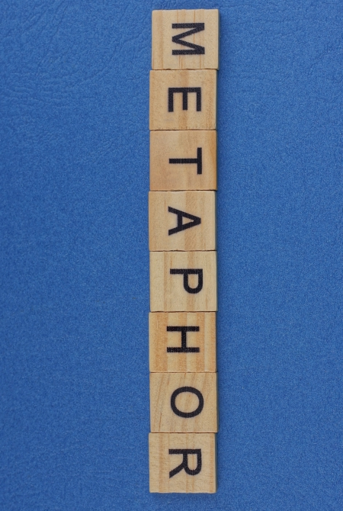
TASK 3
TASK 3
Use the Task 3 resources to complete your task and crack the code! Be sure to record answers on our group answer sheet.
Use the Task 3 resources to complete your task and crack the code! Be sure to record answers on our group answer sheet.
ALLITERATION
ALLITERATION
TASK 4
TASK 4
Use the Task 4 resources to complete your task and crack the code! Be sure to record answers on our group answer sheet.
Use the Task 4 resources to complete your task and crack the code! Be sure to record answers on our group answer sheet.
METAPHOR
METAPHOR
Notes:
These task cards can be printed and placed on the folder or envelope you use for each task. For example, print task cards equal to the number of class groups. Attach the task cards to folders, which inside would have the activities and necessary supplies for each task.

Slide 11
TASK 5
TASK 5
Use the Task 5 resources to complete your task and crack the code! Be sure to record answers on our group answer sheet.
Use the Task 5 resources to complete your task and crack the code! Be sure to record answers on our group answer sheet.
ONOMATOPOEIA
ONOMATOPOEIA
Notes:
These task cards can be printed and placed on the folder or envelope you use for each task. For example, print task cards equal to the number of class groups. Attach the task cards to folders, which inside would have the activities and necessary supplies for each task.

Slide 12
TASK 1
RHYME
Poetry is a special kind of writing. It focuses on feelings and ideas. Poems can be any length. They can be about any subject.
Some poems tell a story. Some poems express the writer’s thoughts and feelings.
All poems have the same basic parts. They include a title, lines, stanzas, rhythm, and sometimes rhyme.
The most common type of rhyme is end rhyme. Poems with end rhyme have lines that end with a word that rhymes with the last word of other lines.
Directions: Watch the assigned video on Gale In Context: Elementary titled “Block City: A Classic by Robert Louis Stevenson.” After you watch, match the correct lines of poetry with end rhyme. When in the right order, the letters will be your code. Put the code on your answer sheet.
- - - - - - - - - - - - - - - - - - - - - - - - - - - - - - - - - - - - - - - - - - - - - - - - - - - - - - -
TASK 1
RHYME
Poetry is a special kind of writing. It focuses on feelings and ideas. Poems can be any length. They can be about any subject.
Some poems tell a story. Some poems express the writer’s thoughts and feelings.
All poems have the same basic parts. They include a title, lines, stanzas, rhythm, and sometimes rhyme.
The most common type of rhyme is end rhyme. Poems with end rhyme have lines that end with a word that rhymes with the last word of other lines.
Directions: Watch the assigned video on Gale In Context: Elementary titled “Block City: A Classic by Robert Louis Stevenson.” After you watch, match the correct lines of poetry with end rhyme. When in the right order, the letters will be your code. Put the code on your answer sheet.

Slide 13
What are you able to build with your blocks?
Castles and palaces, temples and docks.
Block upon block lying scattered and free,
What is there left of my town by the sea?
And see on the steps of my palace, the kings
Coming and going with presents and things!
Now I have done with it, down let it go!
All in a moment the town is laid low.
F
A
B
H
C
G
D
E
Notes:
Students will match the lines of poetry that have the same end rhyme. Once in pairs, they will fill in the missing letter on their answer sheet.

Slide 14
TASK 2
SYLLABLES
Some types of poems are written with a specific number of syllables in mind.
A syllable is a vowel and the letters near it. One syllable is one sound. Two syllables are two sounds.
An easy way to count the number of syllables in a word or sentence is to say it out loud. Put your hand under your chin and as you speak, count how many times your chin touches your hand and that will be the number of syllables.
Haikus are poems written so the first line has 5 syllables, the second line has 7 syllables, and the third line has 5 syllables again.
Directions: Read the assigned poems from “Nature Haikus” to practice counting syllables. Then, compare each pair of haikus and write the title of the poem with the correct number and order of syllables on your answer sheet.
- - - - - - - - - - - - - - - - - - - - - - - - - - - - - - - - - - - - - - - - - - - - - - - - - - - - - - -
TASK 2
SYLLABLES
Some types of poems are written with a specific number of syllables in mind.
A syllable is a vowel and the letters near it. One syllable is one sound. Two syllables are two sounds.
An easy way to count the number of syllables in a word or sentence is to say it out loud. Put your hand under your chin and as you speak, count how many times your chin touches your hand and that will be the number of syllables.
Haikus are poems written so the first line has 5 syllables, the second line has 7 syllables, and the third line has 5 syllables again.
Directions: Read the assigned poems from “Nature Haikus” to practice counting syllables. Then, identify which of the included poems are also haikus and write their title on your answer sheet.

Slide 15
Fish Slimy, scaly fish Drifting in the cool water Slumbering in sand | Grass Grass is very slippery It is delicate and fresh Walking in wet grass
Caterpillar Sweet caterpillar Eating fresh mulberry leaves You are beautiful | Wind Chilly and whirling Feel fall in the air Carrying birds to spring.
Peaches Juicy, ripe, pink Wonderful with smoothies Soft, fluffy peach | Oak Trees Oak trees in the breeze Dropping acorns all around On the ground, good seeds
Sloths Climbing inch by inch Lazily hangs from a branch Brown, slow and tired | Butterfly Flying to every flower High in the blue sky Eating as it goes.
1
2
3
4
Notes:
Students will read each pair of poems and count how many syllables are in each line. Once they have counted, they will identify which poem is a Haiku with the correct 5-7-5 pattern.

Slide 16
TASK 3
ALLITERATION
People use alliteration in writing. Many people use it in poetry.
Alliteration refers to the same sound being used many times. The sound is usually used in a group of words.
The sentence “She sells seashells by the seashore” has alliteration. Some words have an “s” sound. Other words have an “sh” sound.
Directions: Read the assigned document “Alliteration” to learn more about how it is used in poetry. Find your way through the maze by solving which emoji correctly completes each line of alliteration. Record the direction you went with an arrow on your answer sheet.
- - - - - - - - - - - - - - - - - - - - - - - - - - - - - - - - - - - - - - - - - - - - - - - - - - - - - - -
TASK 3
ALLITERATION
People use alliteration in writing. Many people use it in poetry.
Alliteration refers to the same sound being used many times. The sound is usually used in a group of words.
The sentence “She sells seashells by the seashore” has alliteration. Some words have an “s” sound. Other words have an “sh” sound.
Directions: Read the assigned document “Alliteration” to learn more about how it is used in poetry. Find your way through the maze by solving which emoji correctly completes each line of alliteration. Record the direction you went with an arrow on your answer sheet.

Slide 17
START
Silly Sally skipped and sang in the ________.
Buzzing _______ bring bright blooms to the breeze.
Gleeful _________ greet the golden morning glow.
Jumping ___________ joyfully jive in the jar.
☀️
🐻
🦈
🐱
🐝
🐌
🦘
Playful ___________ prance and pounce in the park.
Dancing _________ dive and dazzle in the deep.
Silly __________ scamper and stash shiny acorns.
Bouncing _________ hop and hide in the blooming meadow.
🐎
🐧
🐿️
🦐
🐬
🐍
🐇
Giggling _________ gather by the glittering lake.
Curious cats cuddle and chase colorful ____________.
Slippery __________ slither silently through the grass.
END
🦍
🐛
🦦
Notes:
Students will read each line of alliteration and identify which emoji would correctly complete each. Once they have found their way from start to end, students will record the directions they went to get there as arrows on their answer sheet.

Slide 18
TASK 4
METAPHOR
A metaphor is a comparison. It does not use the words “like” or “as.”
Metaphors compare something directly to something else, in order to create an image or paint a mental picture.
Many famous poets used metaphor in their work like William Shakespeare, Emily Dickinson, Maya Angelou, and Robert Frost.
Directions: Read the assigned document “Metaphors” to learn about the different types you will find in poetry. Then, use the alphabet cipher to crack the code and fill-in-the-blank on some common metaphors from poems. Record the decoded words on your answer sheet under Task 4.
- - - - - - - - - - - - - - - - - - - - - - - - - - - - - - - - - - - - - - - - - - - - - - - - - - - - - - -
- - - - - - - - - - - - - - - - - - - - - - - - - - - - - - - - - - - - - - - - - - - - - - - - - - - - - - -
TASK 4
METAPHOR
A metaphor is a comparison. It does not use the words “like” or “as.”
Metaphors compare something directly to something else, in order to create an image or paint a mental picture.
Many famous poets used metaphor in their work like William Shakespeare, Emily Dickinson, Maya Angelou, and Robert Frost.
Directions: Read the assigned document “Metaphors” to learn about the different types you will find in poetry. Then, use the alphabet cipher to crack the code and fill-in-the-blank on some common metaphors from poems. Record the decoded words on your answer sheet under Task 4.
- - - - - - - - - - - - - - - - - - - - - - - - - - - - - - - - - - - - - - - - - - - - - - - - - - - - - - -

Slide 19
1. Time is a _______ .
2. The world is a ________.
3. Eyes are the _____________ to the soul.
4. ________ is a rose with thorns.
5. The _____________ of night fell upon us.
6. The stars were sparkling ___________ in the sky.
Notes:
Students will use the animal alphabet cipher to decode each word and complete the metaphor.

Slide 20
A | B | C | D
E | F | G | H
I | J | K | L
M | N | O | P
Q | R | S | T
U | V | W | X
Y | Z
Notes:
Students will use this animal alphabet cipher to decode the words on page 19.

Slide 21
TASK 5
ONOMATOPOEIA
Poets use onomatopoeia to help readers enjoy poems. Poems with onomatopoeia allow readers to almost hear what is happening in the poem.
A poet who wants to use onomatopoeia might write: “The wind whooshed through the canyon.” The word whooshed sounds like the noise wind can make. It helps the reader to hear the wind.
Other examples would be animal sounds like moo, bark, and meow. Or sounds people make like gargle, slurp, and munch.
Directions: Read the Gale document “Sound Safari: Exploring the World of Onomatopoeia.” Identify the use of onomatopoeia in each line and fill it in the crossword. Highlighted letters will reveal the code. This is how you finally escape!
- - - - - - - - - - - - - - - - - - - - - - - - - - - - - - - - - - - - - - - - - - - - - - - - - - - - - - -
TASK 5
ONOMATOPOEIA
Poets use onomatopoeia to help readers enjoy poems. Poems with onomatopoeia allow readers to almost hear what is happening in the poem.
A poet who wants to use onomatopoeia might write: “The wind whooshed through the canyon.” The word whooshed sounds like the noise wind can make. It helps the reader to hear the wind.
Other examples would be animal sounds like moo, bark, and meow. Or sounds people make like gargle, slurp, and munch.
Directions: Read the Gale document “Sound Safari: Exploring the World of Onomatopoeia.” Identify the use of onomatopoeia in each line and fill it in the crossword. The highlighted box for each answer makes the code, put them in order from 1 – 13 on your answer sheet. This is how you finally escape!

Slide 22
1
2
3
4
5
6
7
8
9
10
11
12
13
Down
The cat meowed noisily outside the window.
I woke up to the chirping of birds outside my window.
The old door creaked as a I opened it slowly.
My breakfast is sizzling in the hot pan.
The cow mooed and chewed grass in the field.
The dog barked loudly at the mail man.
Across
Boom! The thunder scared me during the storm.
Tick-tock went the clock as we waited for the bus.
I heard the frog go “ribbit” near the pond.
Ding! The bell rang, signaling the end of class.
The snake hissed and slithered away into the grass
I slurped my spaghetti and enjoyed its warm taste.
The bees are buzzing around the flowers in the garden.
Notes:
Students will identify which word in each clue is an example on onomatopoeia and fill in the crossword with that word. The highlighted letters will be their answer in numerical order 1 – 13.

Slide 23
CITATION INFORMATION
TASK 1
'Poetry' (2020) in Gale Elementary Online Collection, Gale, part of Cengage Group, available: https://link.gale.com/apps/doc/GLTDCJ317204877/ITKE?u=[LOCATIONID]&sid=bookmark-ITKE&xid=88631f07 [accessed 02 Jan 2024].
BoClips (2014) 'Block City: A Classic by Robert Louis Stevenson', "Block City" by Robert Louis Stevenson [video], 01 Jan, available: https://link.gale.com/apps/doc/GIIPUN182134852/ITKE?u=[LOCATIONID]&sid=bookmark-ITKE&xid=ced21bba [accessed 02 Jan 2024].
TASK 2
Minoura, N. (2007) 'Nature Haikus', Skipping Stones, 19(4), 15, available: https://link.gale.com/apps/doc/A168361063/ITKE?u=[LOCATIONID]&sid=bookmark-ITKE&xid=353dc0d2 [accessed 02 Jan 2024].
Childress, E. (2013) 'Fish', Skipping Stones, 25(3), 8, available: https://link.gale.com/apps/doc/A332021674/ITKE?u=[LOCATIONID]&sid=bookmark-ITKE&xid=06fe5961 [accessed 02 Jan 2024].
Maring, K. (2013) 'Caterpillar', Skipping Stones, 25(3), 8, available: https://link.gale.com/apps/doc/A332021667/ITKE?u=[LOCATIONID]&sid=bookmark-ITKE&xid=b284c844 [accessed 02 Jan 2024].
Dunn, A. (2013) 'Oak Trees', Skipping Stones, 25(3), 8, available: https://link.gale.com/apps/doc/A332021670/ITKE?u=[LOCATIONID]&sid=bookmark-ITKE&xid=99427b3f [accessed 02 Jan 2024].
Wilson, D. (2013) 'Sloths', Skipping Stones, 25(3), 8, available: https://link.gale.com/apps/doc/A332021666/ITKE?u=[LOCATIONID]&sid=bookmark-ITKE&xid=397243cf [accessed 02 Jan 2024].
TASK 3
'Alliteration' (2021) in Gale Elementary Online Collection, Gale, part of Cengage Group, available: https://link.gale.com/apps/doc/SMASQC564832324/ITKE?u=[LOCATIONID]&sid=bookmark-ITKE&xid=e16c7782 [accessed 02 Jan 2024].
TASK 4
'Metaphor' (2020) in Gale Elementary Online Collection, Gale, part of Cengage Group, available: https://link.gale.com/apps/doc/TFDFZW944488296/ITKE?u=[LOCATIONID]&sid=bookmark-ITKE&xid=967af24c [accessed 02 Jan 2024].
TASK 5
'Onomatopoeia' (2015) in Literature. Gale Elementary Online Collection, Gale, part of Cengage Group, available: https://link.gale.com/apps/doc/VHJCYF378468674/ITKE?u=[LOCATIONID]&sid=bookmark-ITKE&xid=8be6358b [accessed 02 Jan 2024].
'Sound Safari: Exploring the world of Onomatopoeia' (2023) MiniMag, Aug, 20, available: https://link.gale.com/apps/doc/A760049682/ITKE?u=[LOCATIONID]&sid=bookmark-ITKE&xid=af2a314a [accessed 02 Jan 2024].
EXPLORE MORE!
Find more classroom resources and support materials at:
support.gale.com
Notes:
Citation information for each of the task document.

